Slide 1
CS338 Project Differentiable Co-Design of Digital Twin-Enabled Autonomous Vehicles with Deep Reinforcement Learning
Presenter: Ying-Kuan (Rick) Tsai
PI: Prof. Wei Chen
Date: 09/23/2025

Slide 2


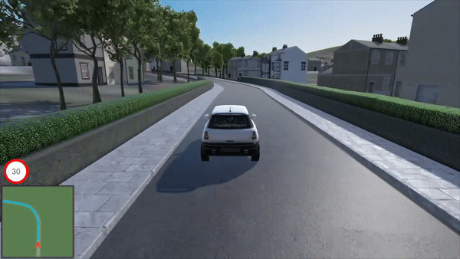



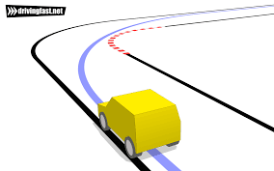

Main Idea
Differentiable Co-Design of Digital Twin-Enabled Autonomous Vehicles with Deep Reinforcement Learning
Motivation: Co-design of autonomous vehicles is limited
(1) Build the environment, (2) Implement the RL algorithms with auto-differentiation, (3) Apply DT with uncertain environments
States:
Actions:
Steering angle
Brake and accelerating
Environment
RL Agent

Slide 3
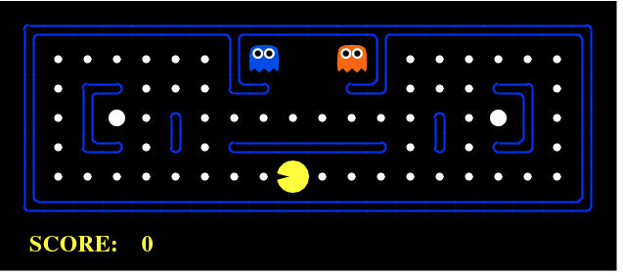
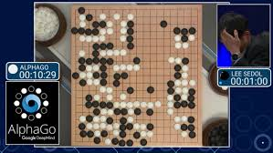
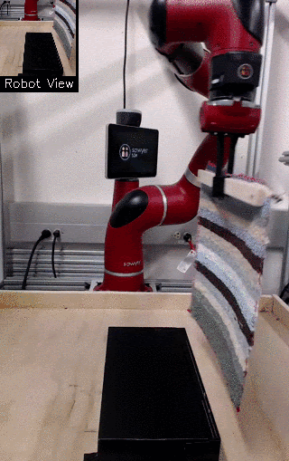


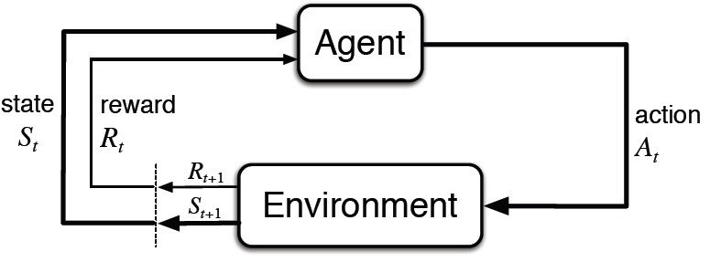





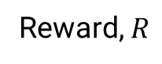
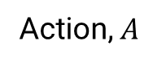
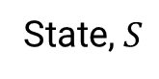
Intro to RL: Key Components and How It Works
Video game (2000-2010)
AlphaGo (2015)
Gnanasekaran et al. (2017). Reinforcement learning in pacman.
https://deepmind.google/research/projects/alphago/
Robotic manipulation (2015 - )
https://robohub.org/
Key components:
Agent
Environment
State, $S$
Action, $A$
Reward, $R$
Sutton. "Reinforcement learning: An introduction." A Bradford Book (2018).
Notes:
Video game (train an agent by playing the video game thousand times) → Board game (Go; very complicated but still finite actions) → real robot control (as sensing and computing power up)
Key components: (1) agent (decision-maker interacting with env), (2) env (game or physics dynamics), (3) state (representation of the current situation the agent is in; whether fully observable is very critical), (4) action (can be discrete like {up, down, left, right} or continuous), (5) reward (how good or bad an action was at the state → guiding the learning process); e.g., +1 for eating a dot and -10 for hitting a ghost

Slide 4
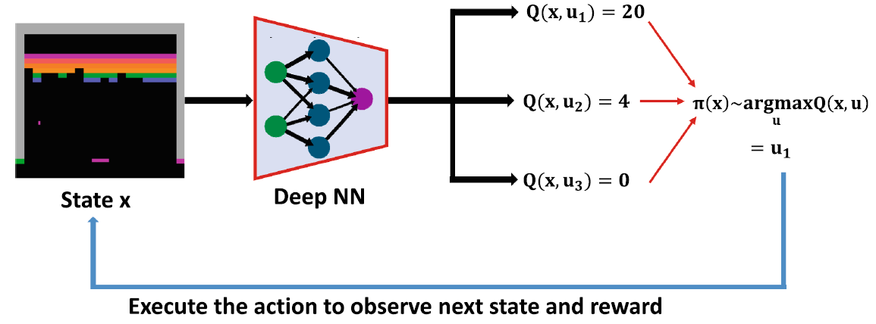
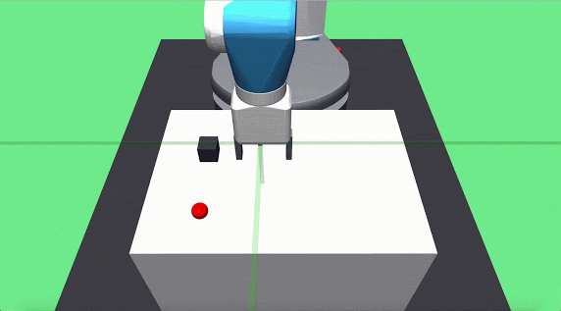
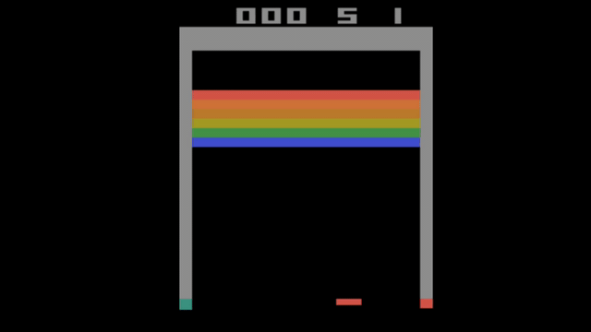
DRL Algorithms
Deep Q-Network (Mnih et al. 2015)
Actor-Critic Algorithms (Konda & Tsitsiklis 1999)
Actor (Policy)
Action
Environment
Error
Critic (Value)
Reward
State
Kurenkov et al. arXiv:1909.04121 (2019)
Actor: Learns the policy (how to act)
Critic: Learns the value function (how good the current behavior is)
Algorithms:
Deep Deterministic Policy Gradient (DDPG) (Lillicrap et al., 2016)
Asynchronous Advantage Actor Critic (A3C) (Mnih et al., 2016)
Trust Region Policy Optimization (TRPO) (Schulman et al., 2015)
Proximal Policy Optimization (PPO) (Schulman et al., 2017)
Uses DNN to approximate the Q value function
Learns policies directly from high-dim image data (pixel)
Not very impressive with continuous control problems
Shakya, A. K., Pillai, G., & Chakrabarty, S. (2023). Reinforcement learning algorithms: A brief survey. Expert Systems with Applications, 231, 120495.
Sutton. "Reinforcement learning: An introduction." A Bradford Book (2018).

Slide 5
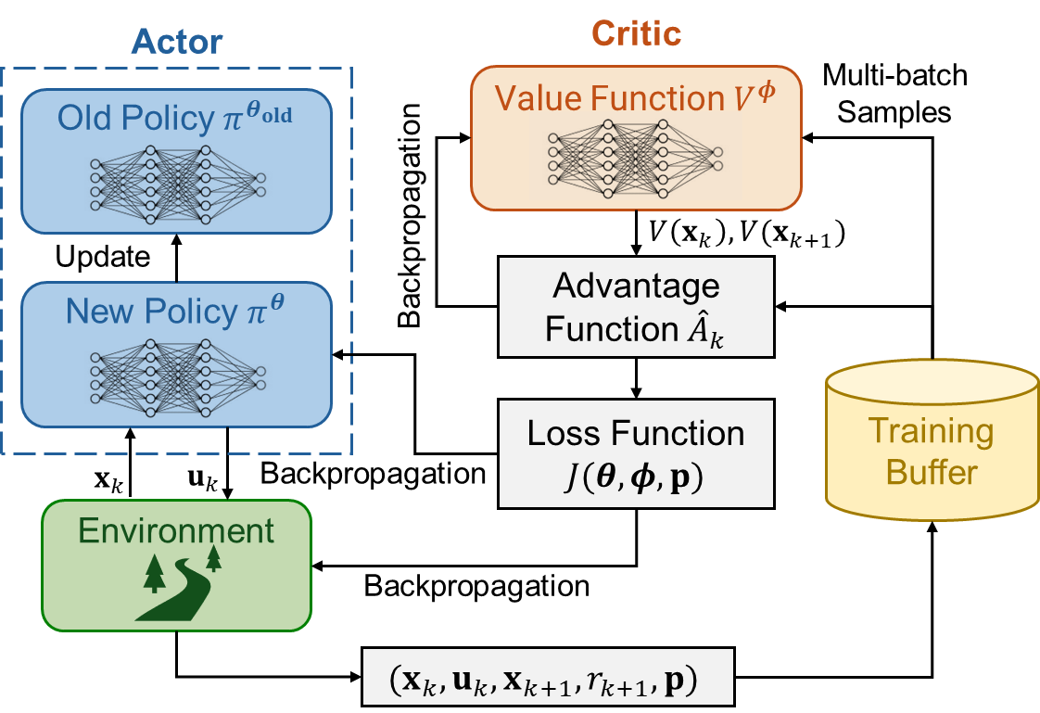
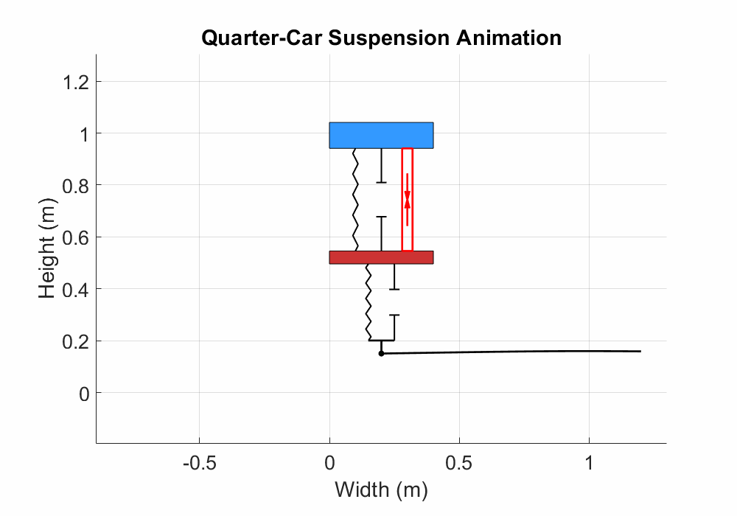
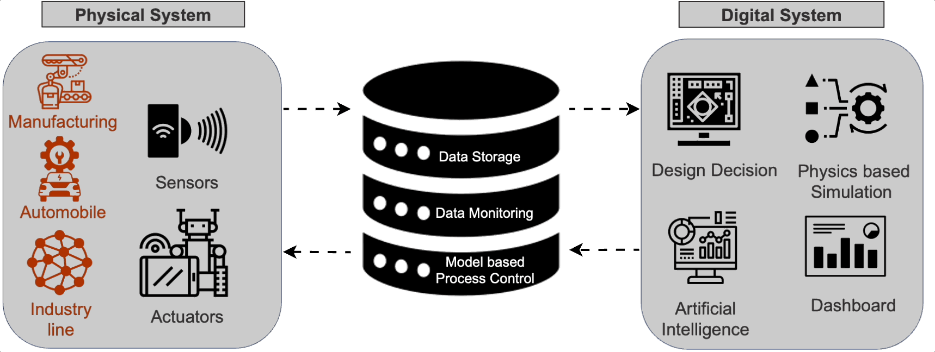


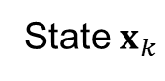
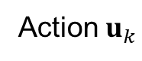
Digital Twin-enabled Co-Design with PPO
(1) Real-time Control, (2) Policy Update, (3) Physical Component Update
Physical System
Digital System
Action $u_{k}$
Policy Update
State $x_{k}$
Model Update
▲Digital Twin framework for active suspension
▲Co-design based on Proximal Policy Optimization (PPO)
Paper and Python codes will be provided
Tsai et al. (2025) J. Mech. Des.
Notes:
Scenario generated for generation 1 for mimicking the implementation in reality
Speed profile: acceleration, deceleration, and constant-speed (noises added)
Road profile: several jumps, bumps, dents, and ramps with some noises over distances

Slide 6
Plan
Week | Date | Task
2 | 9/22 | Introduction
3 | 9/29 | Build driving environment (control: steering, accelerating, brake; system: gear ratio, tire friction) + Learn and implement RL (PPO)
4 | 10/6 | Build driving environment (control: steering, accelerating, brake; system: gear ratio, tire friction) + Learn and implement RL (PPO)
5 | 10/13 | Integrate autonomous driving environment with PPO
6 | 10/20 | Integrate autonomous driving environment with PPO
7 | 10/27 | Manual tuning system parameters
8 | 11/3 | Develop co-design based on PPO
9 | 11/10 | Compare results by manual tuning system parameters and co-design
10 | 11/17 | Refine the results
11 | 11/24 | Thanksgiving holidays
12 | 12/1 | Presentation preparation
13 | 12/8 | Presentation preparation

Slide 7
10/22 Update from Wilson and Adnan
Environment: CARLA
Define the input (actions) and output (positions) of the system
Define the path (racing track)
Define reward function (time spent and penalizing collisions)
Other Metrics (what are important; care about but not in the environment → domain like tire replacement)
What is the optimal configuration
At the same time, find any physical parameters we can change in the environment (such as tires, gear ratios, etc.)

Slide 8
Supplementary Materials

Slide 9
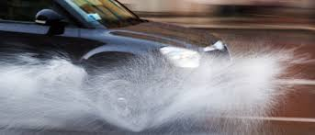

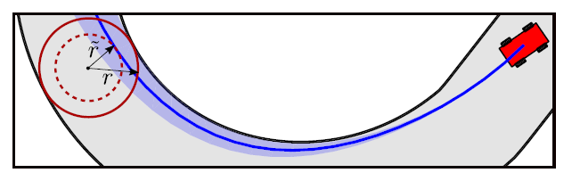
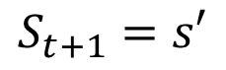
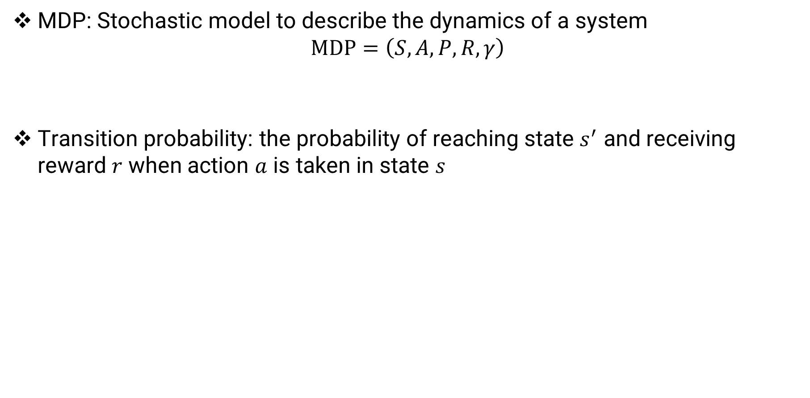
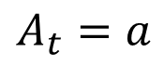
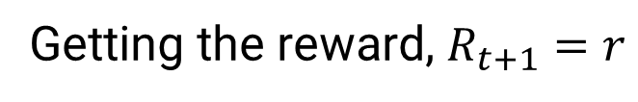
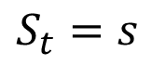
Intro to RL: Markov Decision Process (MDP)
MDP: Stochastic model to describe the dynamics of a system $MDP=\left(S,A,P,R,γ\right)$
Transition probability: the probability of reaching state $s^{′}$ and receiving reward $r$ when action $a$ is taken in state $s$
S: State Space, A: Action Space, P: Transition Probability, R: Reward Function, $γ$: Discount Factor
$$A_{t}=a$$
Getting the reward, $R_{t+1}=r$
$$S_{t}=s$$
$$S_{t+1}=s′$$
$$p\left(s^{′},r | s,a\right)=\operatorname{Pr}\left\{S_{t+1}=s^{′},R_{t+1}=r \right|S_{t}=s,A_{t}=a\}$$
Hewing et al. IEEE Trans. Ctrl Sys. Tech., 2019
Notes:
Before RL problems, we should know how we define a “model” for RL → Markov Decision Process (MDP)
Transition probability: If I do action a in state s, what’s the chance I’ll end up in state s′ (stochastic nature of the environment, e.g., actions are the same but weather affects friction between tire and road → critical to turning)

Slide 10
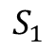
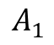
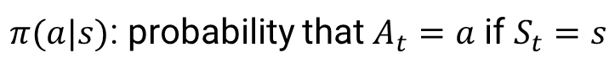
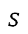
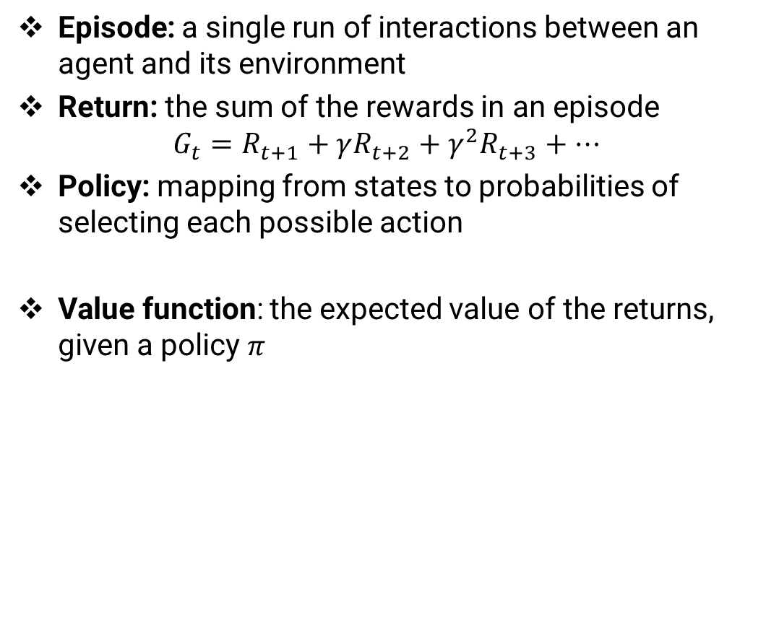
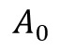
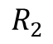
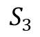
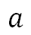
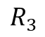
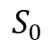
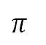
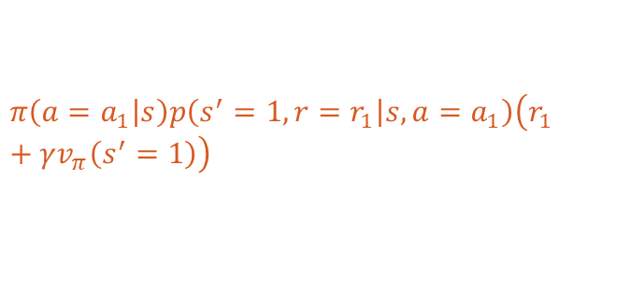

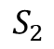
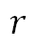
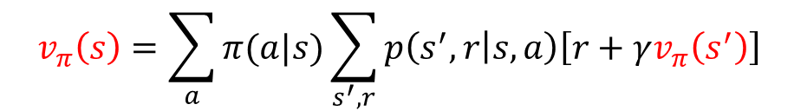
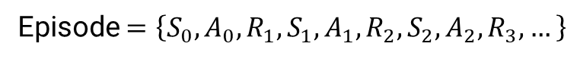
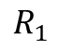
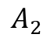
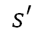
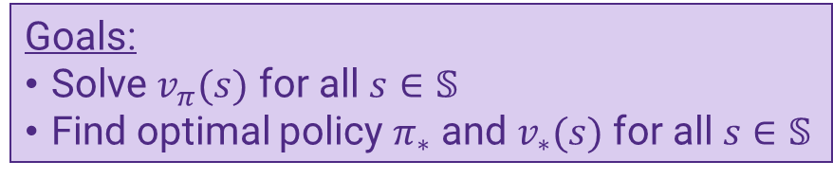
Intro to RL: Episode, Return, Policy, and Value
Episode: a single run of interactions between an agent and its environment
Return: the sum of the rewards in an episode $G_{t}=R_{t+1}+γR_{t+2}+γ^{2}R_{t+3}+…$
Policy: mapping from states to probabilities of selecting each possible action
Value function: the expected value of the returns, given a policy $π$
$$⋯$$
$$A_{0}$$
$$A_{2}$$
$$S_{3}$$
$$S_{0}$$
$$A_{1}$$
$$S_{2}$$
$$R_{3}$$
$$R_{1}$$
$$S_{1}$$
$$R_{2}$$
Episode $=\left\{S_{0},A_{0},R_{1},S_{1},A_{1},R_{2},S_{2},A_{2},R_{3},…\right\}$
$π(a|s)$: probability that $A_{t}=a$ if $S_{t}=s$
$$r$$
$$s′$$
$$π$$
$$a$$
$$π\left(a=a_{1} | s\right)p\left(s^{′}=1,r=r_{1} | s,a=a_{1}\right)\left(r_{1}+γv_{π}\left(s^{′}=1\right)\right)$$
$$v_{π}\left(s\right)=𝔼_{π}\left[G_{t} \right| S_{t}=s]=𝔼_{π}\left[R_{t+1}+γG_{t+1}\right| S_{t}=s]$$
$$s$$
$$v_{π}\left(s\right)=\sum_{a}{π(a|s)}\sum_{s^{′},r}{p\left(s^{′},r | s,a\right)\left[r+γv_{π}\left(s^{′}\right)\right]}$$
Goals:
Solve $v_{π}(s)$ for all $s∈𝕊$
Find optimal policy $π_{∗}$ and $v_{∗}(s)$ for all $s∈𝕊$
Bellman equation (policy evaluation)
Notes:
Policy: how it chooses actions based on the state

Slide 11
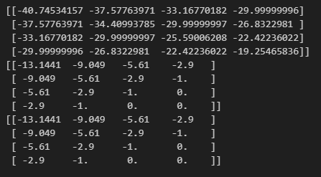

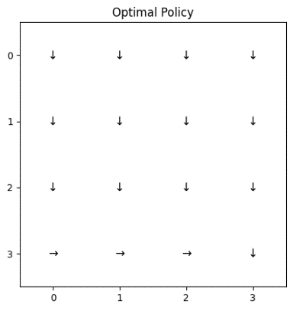
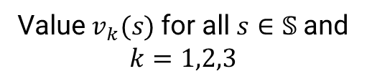
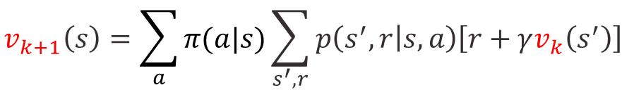
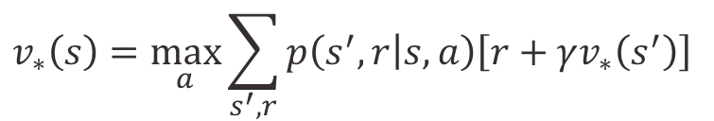


Dynamic Programming (DP) Algorithms
Bellman Optimality Equation: the value of a state under an optimal policy must equal the expected return for the best action from that state
Example: Frozen-Lake (reward = - distance to the goal)
$$v_{∗}\left(s\right)=\max_{a}\sum_{s^{′},r}{p\left(s^{′},r | s,a\right)\left[r+γv_{∗}\left(s^{′}\right)\right]}$$
DP algorithms: compute optimal policies given a perfect model of the environment as MDP
Policy Evaluation
Value $v_{k}(s)$ for all $s∈𝕊$ and $k=1,2,3$
Repeat until convergence:
$$v_{k+1}\left(s\right)=\sum_{a}{π(a|s)}\sum_{s^{′},r}{p\left(s^{′},r | s,a\right)\left[r+γv_{k}\left(s^{′}\right)\right]}$$
Policy Iteration
Limitations of DP Algorithms:
Require model (need to know $p$ and the reward function)
Computationally expensive (impractical if there are many states and actions)
Repeat until convergence:
$v_{k+1}←$ Policy Evaluation
$π_{k+1}(s)←\arg{\max_{a}{\sum_{s^{′},r}{p\left(s^{′},r | s,a\right)\left[r+γv_{π_{k}}\left(s^{′}\right)\right]}}}$ for all $s∈𝕊$ (Policy Improvement)

